Slide 1
Creating Presentations – A Cautionary Tale
Matt Boles, Learning Specialist
mboles@brightcove.com

Slide 2
What We Do Not Want
https://vimeo.com/84433736

Slide 3
A Touch of Learning Theory
Madeline Hunter (Mastery Learning) and Benjamin Bloom (Taxonomy of Learning) are giants in the history of learning and teaching. Both created foundations on which much of how we learn and teach today in America is still in use.
Madeline Cheek Hunter defined teaching as a series of decisions that take place in three realms: content, learning behaviors of students, and teacher behaviors. Content refers to the specific information, skill, or process that is appropriate for students at a particular time.
In 1956, Benjamin Bloom with collaborators published a framework for categorizing educational goals: Taxonomy of Educational Objectives. Familiarly known as Bloom’s Taxonomy, this framework has been applied by generations of K-12 teachers and college instructors in their teaching.
The framework elaborated by Bloom and his collaborators consisted of six major categories: Knowledge, Comprehension, Application, Analysis, Synthesis, and Evaluation. The categories after Knowledge were presented as “skills and abilities,” with the understanding that knowledge was the necessary precondition for putting these skills and abilities into practice.
In order to successfully implement Hunter's methods, teachers undergo extensive professional development that conveys the types of decisions they must make. Training includes viewing
tapes that demonstrate effective decision-making in the classroom, and the Teaching Appraisal for Instructional Improvement Instrument (TAIII), administered by a trained observer or coach, which diagnoses and prescribes teacher behaviors to increase the likelihood of student learning.
A group of cognitive psychologists, curriculum theorists and instructional researchers, and testing and assessment specialists published in 2001 a revision of Bloom’s Taxonomy with the title A Taxonomy for Teaching, Learning, and Assessment. This title draws attention away from the somewhat static notion of “educational objectives” (in Bloom’s original title) and points to a more dynamic conception of classification.

Slide 4
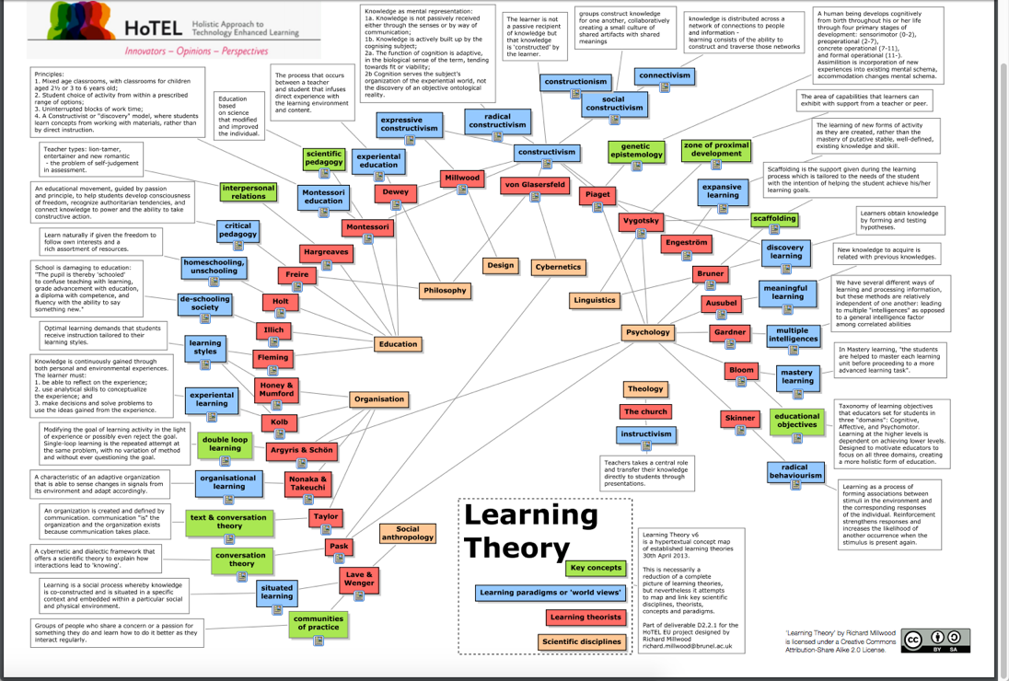
Diagrams Always Help Clarify

Slide 5
Introducing the Session

Slide 6

Learning Points
Session attendees will learn guidelines on how to
Create slides that don't annoy an audience
Structure presentation to help audience learn
Determine appropriate amount of content
Theory into practice
“How does this help me write my PLAY presentation”

Slide 7
DO Grab the Audience’s Attention

Slide 8
Attention Grabbing Techniques
Create an Element of Surprise
Tell a Story
Involve the Audience
Appeal to Multiple Senses

Slide 9
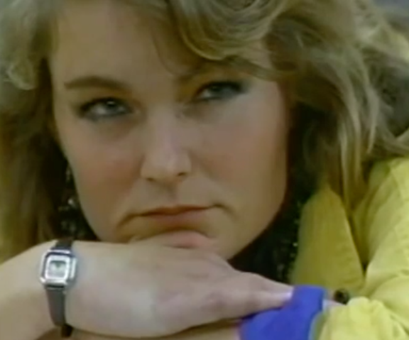
Don't Annoy the Audience

Slide 10
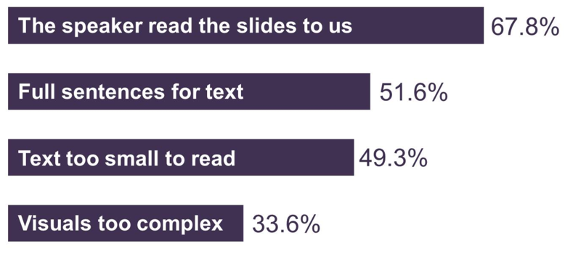
2017 Annoying PowerPoint Survey Results
Source: https://www.thinkoutsidetheslide.com/free-resources/latest-annoying-powerpoint-survey-results/

Slide 11
Presentation Tips from Apple
Grab Attention - Your audience will give you about 90 seconds to grab their attention
Avoid bullet points - Use photos, images, and words
Create headlines - Don’t make hard to find the headline (or in our case, the learning point)
Source: forbes.com – 8 Presentation Techniques You Can Copy From Apple's WWDC Keynote

Slide 12
DON’T Just Talk

Slide 13
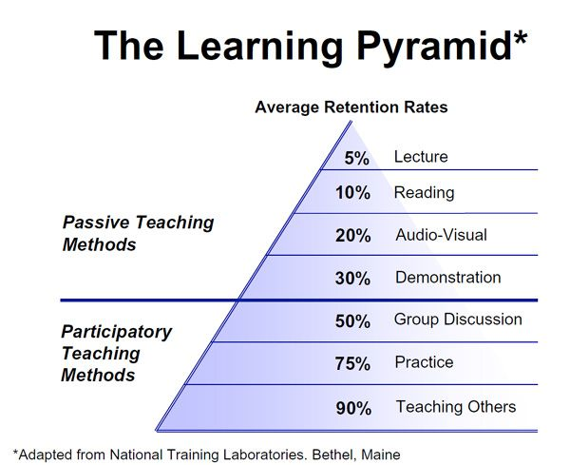
The Learning Pyramid
Because you speak about a topic, or show words about a topic, doesn’t mean it is learned

Slide 14
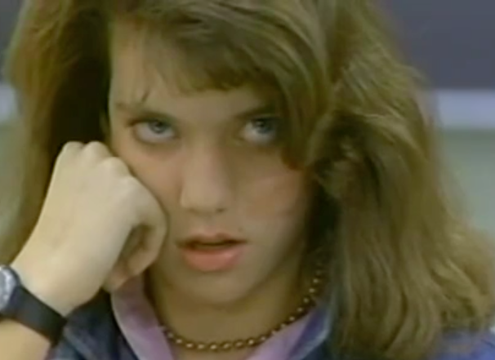
Structure Presentation to Help Audience Learn
Not all content is created equal

Slide 15
Presentation Structure Increases Learning
STEP | JUSTIFICATION
Anticipatory Set | Focus students' thoughts on what will be learned
Objectives | Students learn more effectively when they know what they are supposed to be learning and why
Input | The new knowledge, process or skill must be presented in an effective manner
Modeling | It is important for students to "see" what they are learning
Checking for Understanding | It is important to make sure there is understanding of what was presented by asking questions
Guided Practice | The students need to practice the new learning under supervision
Closure | At the end of each topic it is important to review or wrap up the lesson by posing questions to check for successful learning
Source: Madeline Hunter’s Mastery Learning

Slide 16
But For Us …
STEP
Anticipatory Set
Objectives
Input
Modeling
Checking for Understanding
Guided Practice
Closure
Tell ‘em what you are going to tell ‘em
Tell ‘em
Tell ‘em what you told ‘em
Source: Madeline Hunter’s Mastery Learning

Slide 17

Use “Signposts” for Shifts in Topics
Presentation/public speaking technique to lead an audience through the different stages of your presentation
Examples
In this presentation, the blue slides
“I am now moving on to the next topic”
Show an demo of next learning point in action
Remember, you know the content and flow of your presentation, audience does not

Slide 18
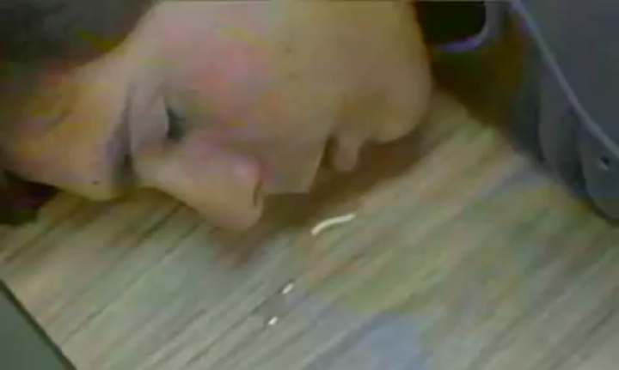
Determine Appropriate Amount of Content for the Presentation
More is NOT always better

Slide 19
The Learning Pyramid
Because you speak about a topic, or show words about a topic, doesn’t mean it is learned

Slide 20
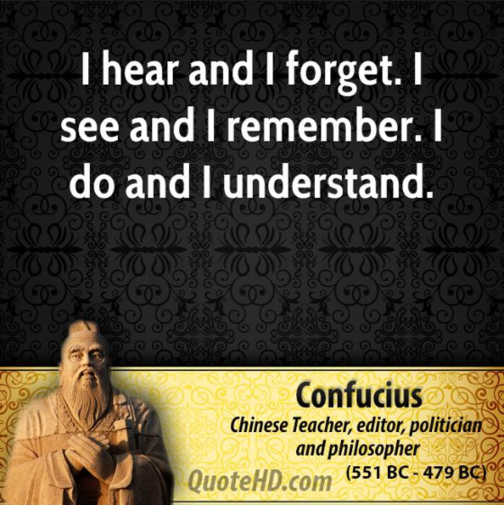
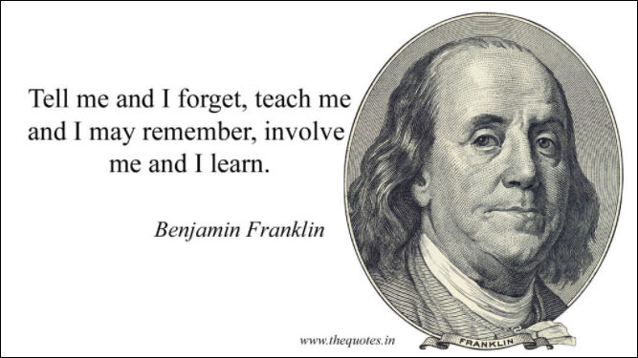
The Learning Pyramid Concept Is Not New

Slide 21
Theory Into Practice

Slide 22
Major Sections for a PLAY Presentation
The “hook” – Grab attention (at least demo what you are going to discuss)
State objectives/learning points – What major points should attendees learn
Content – Objectives/learning points material that teaches why/how (more on the “how” in a few slides)
Review – All your major objectives/learning points reviewed
Q & A

Slide 23
Choosing Your Content
For each learning point, remember the more ways you can communicate the learning point, the better
Of course, be mindful of time constraints
Better to “teach” fewer learning points that attendees remember, than “present” leaning points that are immediately forgotten

Slide 24
Share Knowledge to Solve the Learning Puzzle
Use Cases
Demos
Ask Questions
Tips/
Tricks/Traps

Slide 25
Please Apply What You Have Learned
A checklist will be supplied that incorporates the learning points in this presentation to help guide the development of your presentation
A PLAY template will be supplied for use
One Learning Services team member will review your presentation and work with you if improvements are needed

Slide 26
One more time …

Slide 27
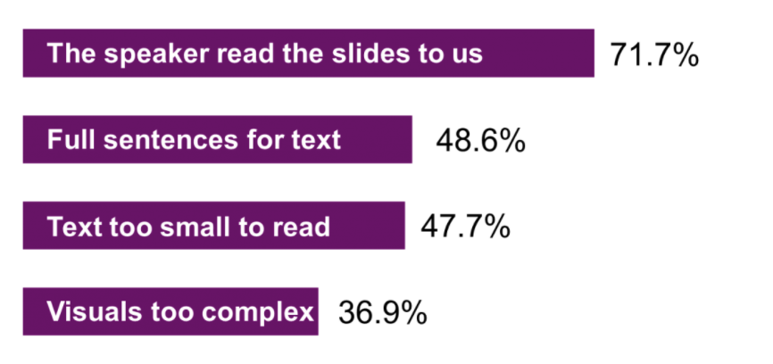
Create Slides that Don't Annoy an Audience

Slide 28
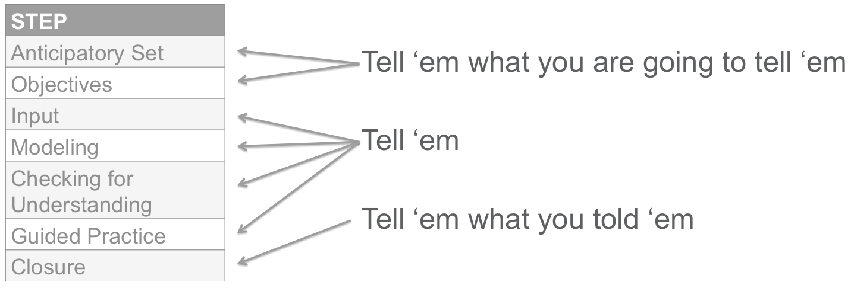
Structure Presentation to Help Audience Learn

Slide 29
Determine Appropriate Amount of Content

Slide 30
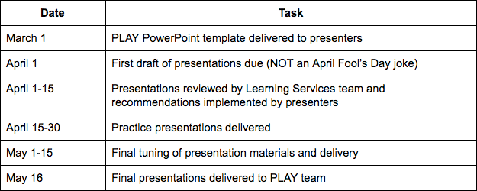
Moving Forward
Use the checklist when creating your PLAY presentations
Practice delivery of the presentation numerous times to ensure correct timing and smooth delivery
Timeline

Slide 31
Thank You!
Matt Boles
mboles@brightcove.com

